Slide 1
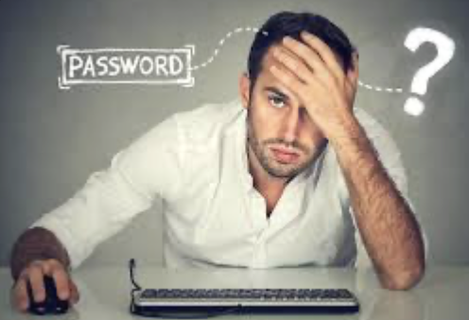
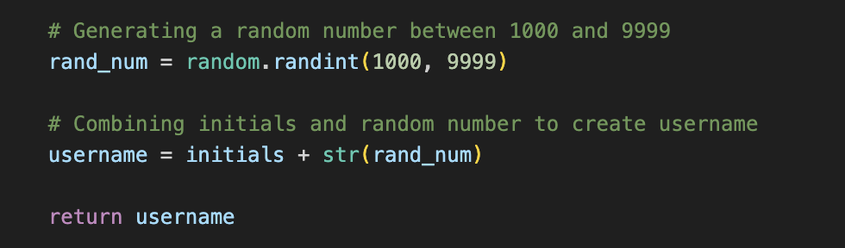
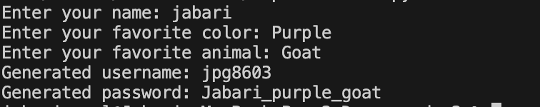

Tired of Signing Up ?
This new code makes it fast and simple to take some things that you like and generate a fun username and safe password.
By Jabari Oneal

